Slide 2
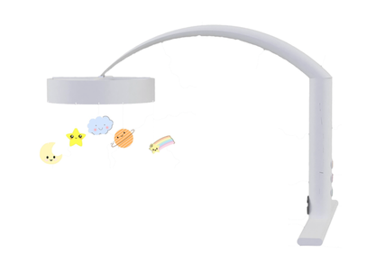
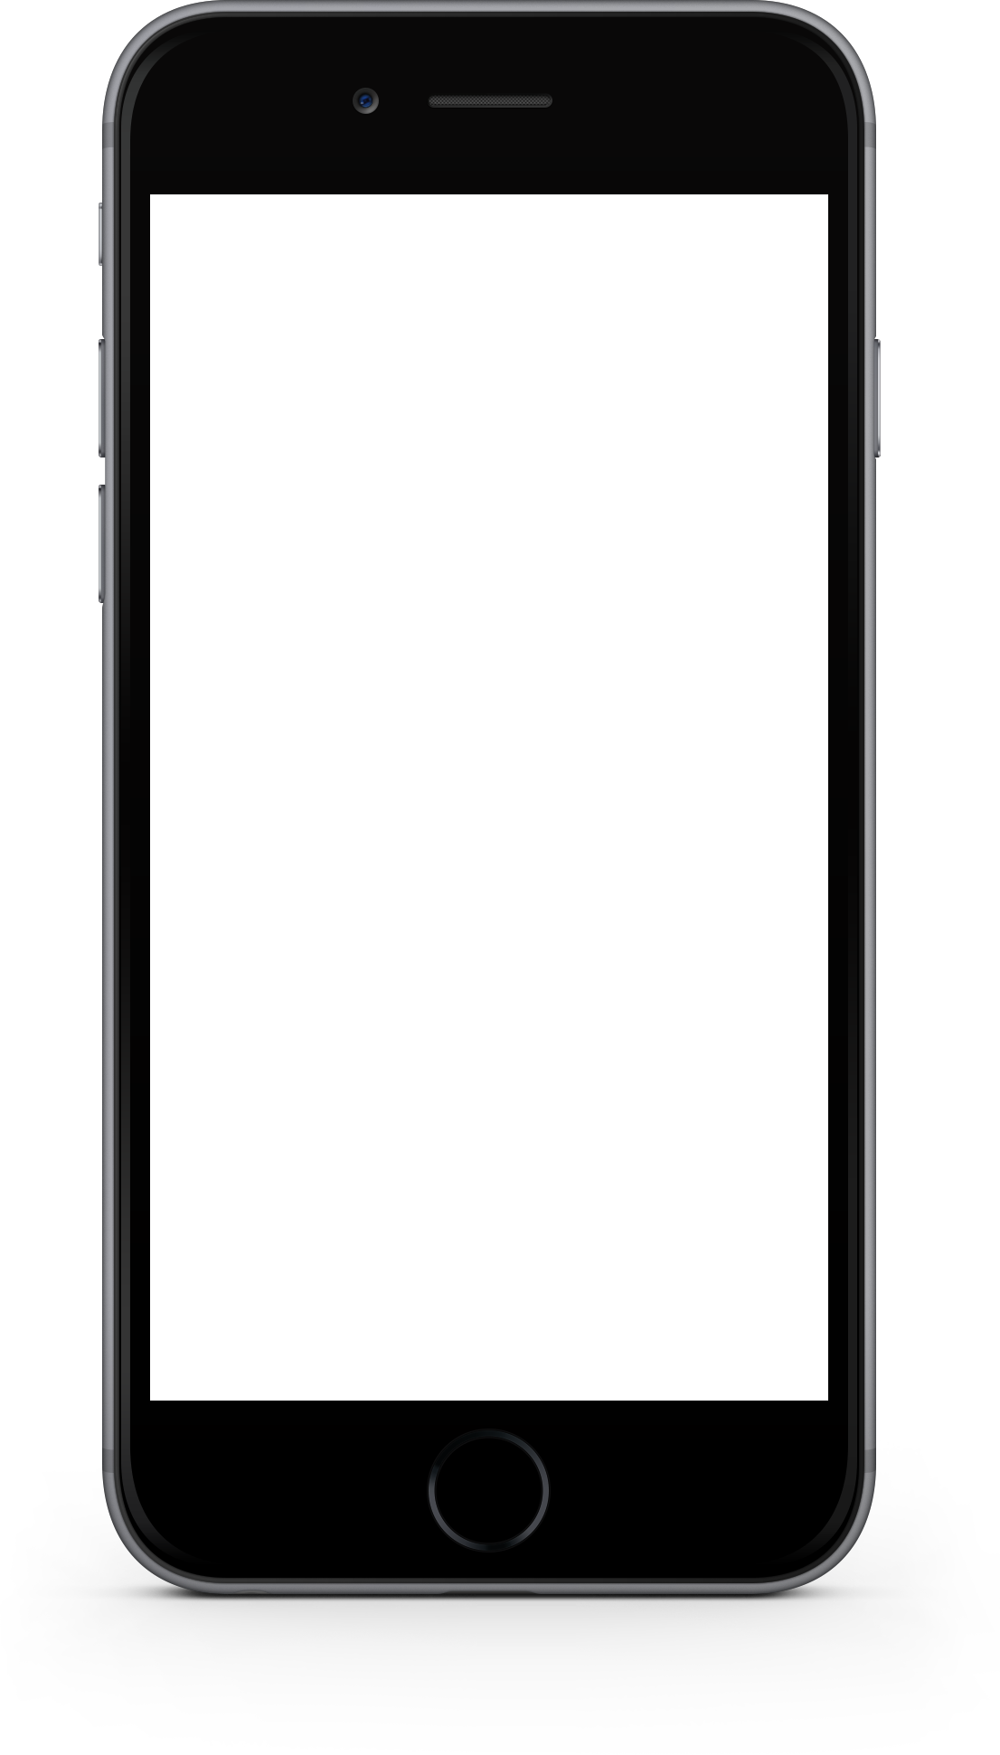
What makes the the Zzz’ Mobile unique?
The Baby Mobile that Records your Voice…
Key Features:
Built-in voice recorder
Bluetooth connectivity
Smartphone app
Preset melodies
Transitions into music box

Slide 3
How It All Started
1
2
3
What problem are we solving?
The trend of technology
The toy industry

Slide 4
Our Mission
Founded in 2016, we created the Zzz’ Mobile with one goal in mind – to offer an innovative, personalized, and technology-driven baby mobile that fits every parents’ needs. We are committed to creating meaningful connections with our consumers by encouraging strong relationships between them and their most prized possessions.

Slide 5
Necessary Funding
Paid in Capital Breakdown
Year 0 | $ 392,693
Year 1 | $ 580,904
Year 2 | $ 485,481
Year 3 | $ 317,029
Year 4 | $ 95,607
Year 5 | $ -
Total Paid In Capital | $ 1,871,714
We will need:
$1,071,714
in funding over the course of the first four years
Founders will fund $800,000

Slide 6
Why should you invest in us?
01
02
03
04
How will we sell it?
How will we make it?
When will you be repaid?
What risks will we face?
Customers
Distribution
Ad Campaigns
Web Presence
Suppliers
Our process
Capacity
Cost
Economies of Scale
Sales
Profits
Start-up costs
Terminal value
NPV
IRR
Low retail presence
Low WIP
Awareness
Competition
Mitigation

Slide 7
How Will We Sell It?

Slide 8
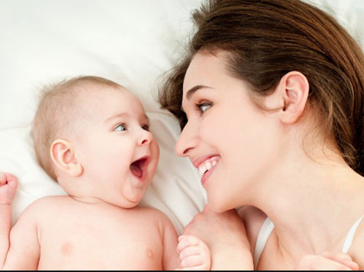
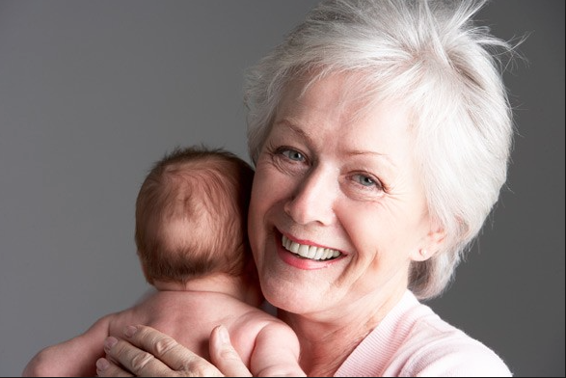
Target Market: Tech-Savvy Mothers & Grandmothers
Techno Babes:
6,894,758 consumers
Silver Foxes:
2,917,013 consumers

Slide 9
Find the Zzz’ Mobile at a Retailer Near You
Small Chains
Large Chains
Mass Merchandisers
Year
1
Year
2
Year
3
Year
4
Year
5
Independent Stores
Online

Slide 10
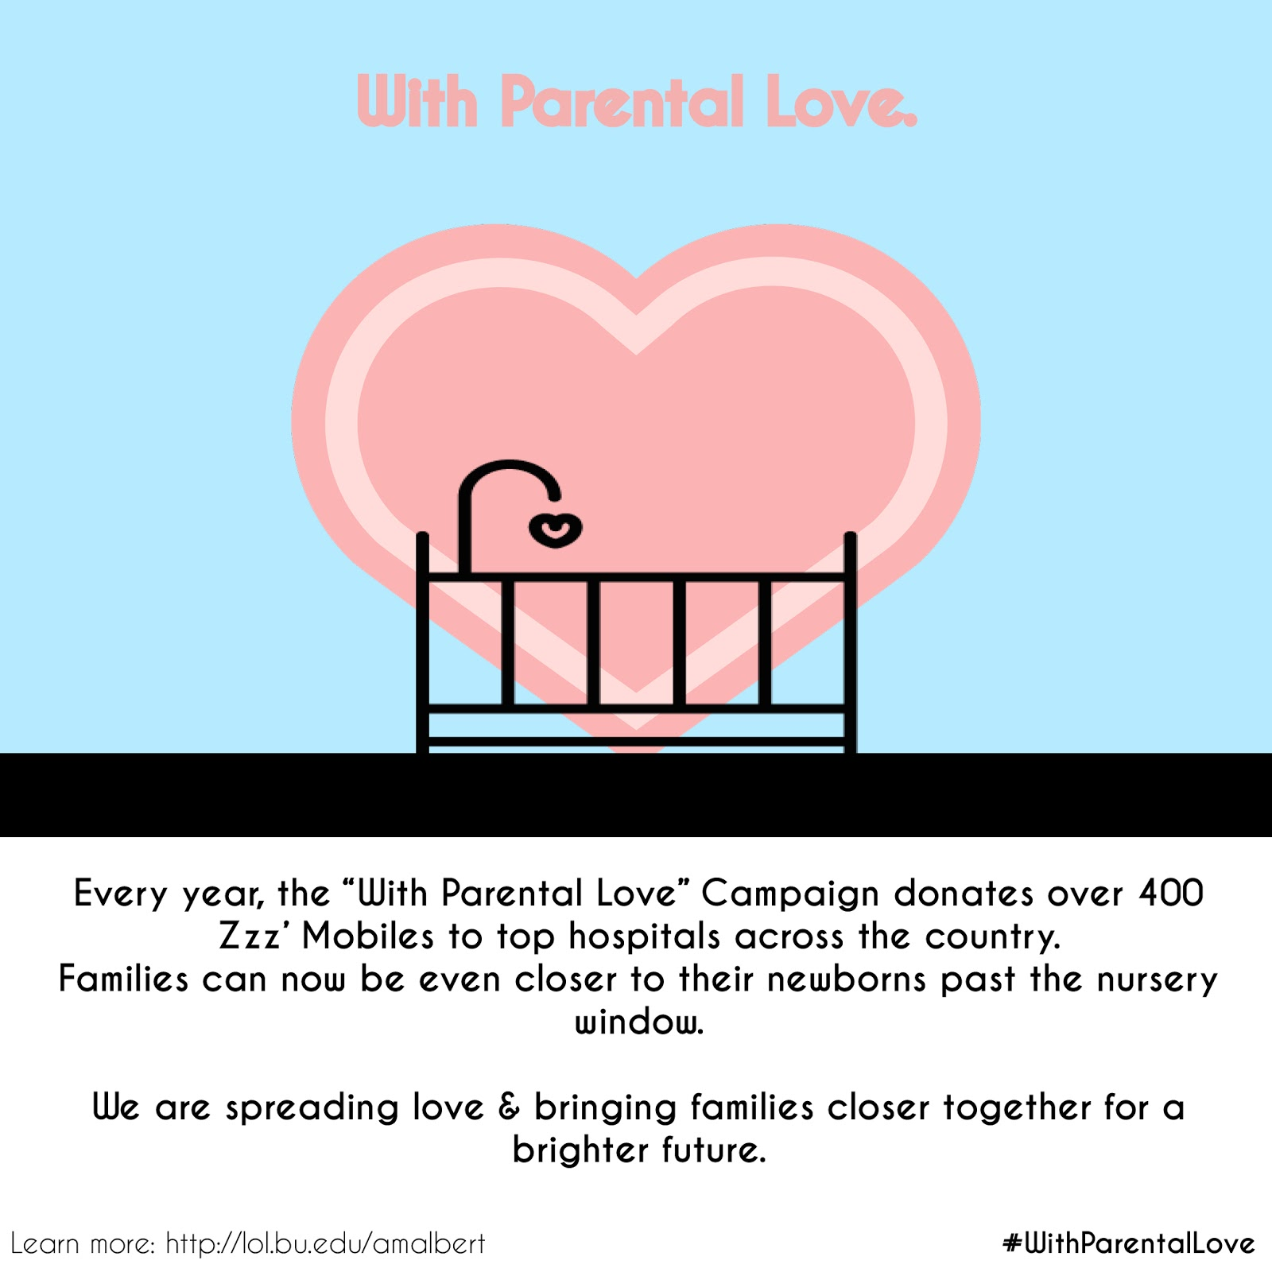
Campaign Highlights: “With Parental Love”
Over 400 Donated Zzz’ Mobiles
7 Locations
Year 0: 1% Awareness
Year 5:
Techno Babes - 11.8%
Silver Foxes - 9.2%

Slide 11



Campaign Highlights: Magazine Ad Boost!
Pregnancy & Newborn
Parents
Zzz’ Mobile
Holiday Ad
(Year 3)
Techno Babes - 1.3%
Silver Foxes - 3%
Techno Babes - 9%
Silver Foxes - 4.3%

Slide 12
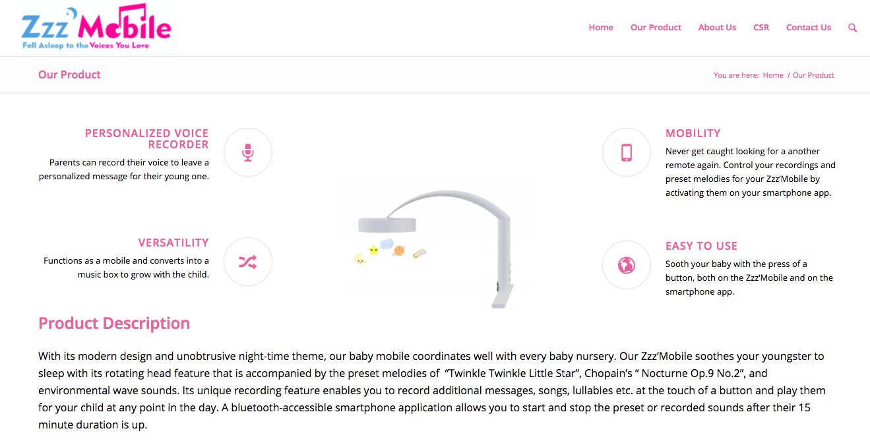
Campaign Highlights: The Web of Everything
lol.bu.edu/amalbert

Slide 13
How Will We Make It?

Slide 14
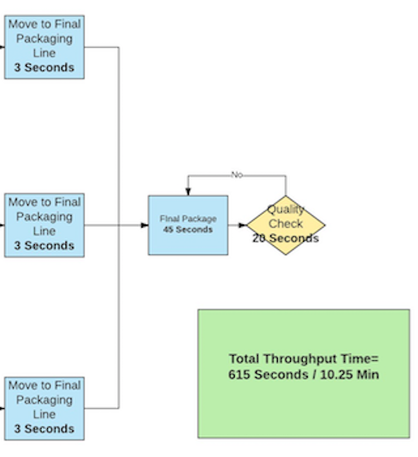
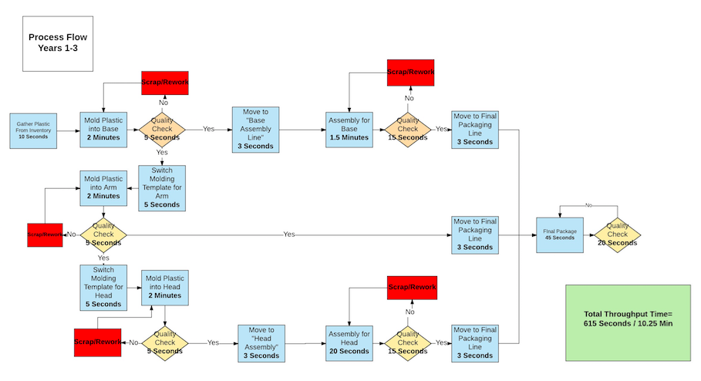
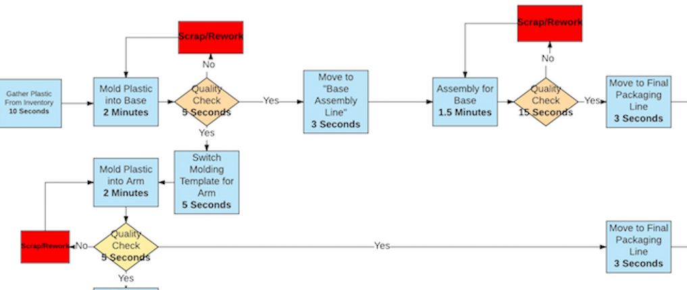
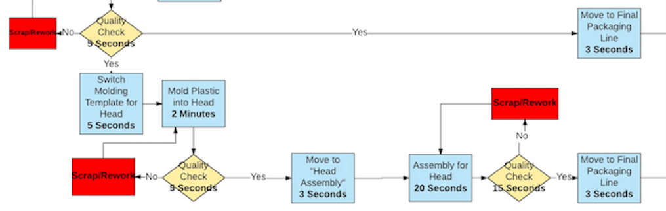
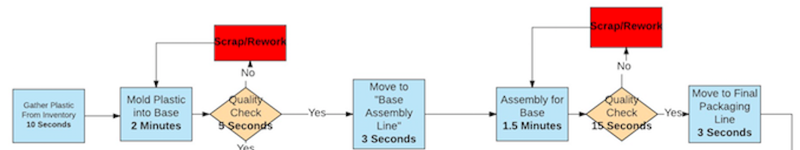
How is the Zzz’ Mobile Made?
Notes:
Explain process flow for years 1-3, talk about need for more capacity, expansion of process flow
Talk about quality checkpoints-->ensure good products for consumers which will make them happy

Slide 15
How Many Zzz’ Mobiles We Can Make
Year | Year 0 | Year 1 | Year 2 | Year 3 | Year 4 | Year 5
Factory Cycle Time (min) | 2.17 | 2.17 | 2.17 | 2.17 | 0.72 | 0.72
Factory Capacity (Units/yr) | 50,733 | 50,733 | 50,733 | 50,733 | 152,257 | 152,257
Capacity Utilization | 2.31% | 25.88% | 45.51% | 90.61% | 42.63% | 98.52%

Slide 16
Who are our suppliers?
Global Reach
Products ship from various suppliers in China, through Shenzhen, China to Miami, FL
Miami, FL
Receiving
Shenzhen, China
Shipping-out

Slide 17
When Will You Be Repaid?

Slide 18
Good Marketing Means Sales
 | Year 1 | Year 2 | Year 3 | Year 4 | Year 5
Weighted Manufacturer's Selling Price | $ 37.55 | $ 36.73 | $ 35.80 | $ 34.66 | $ 32.32
Independent Toy Stores | 2,273 | 5,820 | 11,994 | 11,469 | 10,728
Online Sales | 11,867 | 17,269 | 26,793 | 32,024 | 49,925
Small Chain Toy Stores |  |  | 5,706 | 9,549 | 11,909
Large Chain Toy Stores |  |  |  | 11,882 | 63,300
Mass Merchandisers |  |  |  |  | 26,558
Total Sales | $ 530,899 | $ 847,938 | $ 1,592,788 | $ 2,249,921 | $ 5,248,947

Slide 19
High Costs Hurt Profits
 | Year 1 | Year 2 | Year 3 | Year 4 | Year 5
Revenue | $ 530,899 | $ 847,938 | $ 1,592,788 | $ 2,249,921 | $ 5,248,947
COGS | $ 427,859 | $ 568,477 | $ 872,229 | $ 1,123,737 | $ 2,381,752
SG&A Expense | $ 397,299 | $ 438,573 | $ 621,611 | $ 700,395 | $ 1,013,755
Operating Expense | $ 252,519 | $ 261,440 | $ 262,178 | $ 254,360 | $ 390,474
CSR | $ - | $ - | $ - | $ 15,384 | $ 27,846
Taxes | $ - | $ - | $ - | $ 54,458 | $ 502,292
Net Income | $ (576,778) | $ (420,553) | $ (163,230) | $ 101,136 | $ 932,828

Slide 20
$250,076 To Make Zzz’ Mobile A Reality
Year 0 Cost of Goods Produced
 |  | Per Unit | Per Year
Variable | Direct Materials | $ 9.67 | $ 11,316
 | Direct Labor | $ 5.16 | $ 6,041
Fixed | Indirect Materials | $ 1.43 | $ 1,670
 | Indirect Labor | $ 0.43 | $ 500
 | Mfg. Facilities | $ 1.43 | $ 1,670
 | Mfg. Equipment | $ 38.20 | $ 44,694
 | Mfg. IT | $ 63.65 | $ 73,305
 | Mfg. Utilities | $ 2.26 | $ 2,650
 | Mfg. Insurance | $ 0.13 | $ 150
 | Total Cost of Goods Produced | $136.92 | $160,201
Year 0 Start Up Costs
Product Development
$ 7,500
Pre-Marketing Expenses
$ 82,375
Cost of Goods Produced
$ 160,201

Slide 21
NPV, IRR, & Terminal Value
Terminal Value
$6,340,670
IRR
40.84%
NPV
$1,060,128

Slide 22
Increasing Dividends Started From Year 5
$1.25m
$1.17m
$1.08m
$997k
$241k
Year 5
Year 6
Year 7
Year 8
Year 9
Projected Schedule of Dividends

Slide 23
What Risks Will We Face?

Slide 24
Breakeven by Year 4
 | Year 1 | Year 2 | Year 3 | Year 4 | Year 5
Units Sold | 14,549 | 23,499 | 44,903 | 65,333 | 162,830
Revenue | $530,898 | $847,937 | $1,592,787 | $2,249,920 | $5,248,946
Break Even Units | 39,783 | 43,324 | 52,847 | 57736 | 90904
Break Even Revenue | $1,451,630 | $1,563,306 | $1,874,555 | $1,988,278 | $2,930,357
Margin of Safety (U) | (25,233) | (19,825) | (7,943) | 7,598 | 71,926
Margin of Safety (%) | (63.43%) | (45.76%) | (15.03%) | 13.16% | 79.12%

Slide 25


Risk 1: Loss to Competition
The key to surviving this risk:
-Increasing marketing expenses by 100K in Year 3
-Implement new training programs for sales force
05
04
03
Maintain a positive NPV: $600K
02
Mitigation Strategies
01
25% Risk Probability
Largest Distribution for NPV
Third Most Sensitive
Increase Competition Adjustment Respectively
Notes:
Loss to competition equates to less sales because our competitors might produce similar products for cheaper or better products all around
Estimated loss of competition due to market research based on how much market share competitors already have (mattel and fisher price)
Estimation: 20%, 27%, 35%
Sensitivity:
-23% for NPV of 0, -28% for IRR of 0
Technically the third most sensitive variable
change in 1% = $46,706 in NPV
Risk Analysis: 25% probability
Assigned probability of 25%: competition adjustment directly affects the units (ACV, awareness, purchase intent, competition), 1 of 4
New Assigned competition: YR 3- 30%, YR 4- 35%, YR 5- 42%
Largest standard deviation of all of the variables, lowest minimum/mean/value at risk
Mitigation:
Turn a profit in Year 4 and have an ending NPV after Year 5 of $599,223 with an IRR of 32.28%.
Money would come from sales
Alter our training programs to increase the success of salespeople
The expected impact of fiercer competition in the toy market of similar product at similar price is $384,761 on NPV.

Slide 26
Risk 2: Lower Purchase Intent from Recession
The key to surviving this risk:
-Increasing marketing expenses by 100K in Year 3
-Lower our manufacturing suggested retail price by $5 each year
05
04
03
Maintain a Positive NPV: $300K
02
Mitigation Strategies
01
33% Risk Probability
Second Largest Distribution for NPV
Second Most Sensitive
Economic Recession:
Purchase Intent Decrease by 2% Annually

Slide 27
Final Answer???
How Will We Sell It
Strong ad campaign, retail penetration, joining technological trends
How We Make Our Product
Made in Florida, Working at high capacity utilization
When You Will Be Repaid
Repayments beginning in Year 5, projected repayment in Year 6
What Risks We Face
Mitigation plans in place for all foreseen risks
$ 1,071,714 Required By Investors

Slide 28
Questions?

Slide 29
Backup Slides
Billboard Ad
BASES Model – Techno Babes
BASES Model – Silver Foxes
Agg. Demand Yr.0
Agg. Demand Yr.1
Agg. Demand Yr.2
Agg. Demand Yr.3
Agg. Demand Yr.4
Agg. Demand Yr.5
Sensitivity Analysis Output
Risk Simulation Tornado Chart
Statement of Cash Flows
CSR Ad
Mall Ad
IMC Yr1
IMC Yr3
IMC Yr5
Segmentation Tree
Avg. Weighted Manufacturers Selling Price
Risk Simulation – ACV
Risk Simulation Output
Income Statement
Balance Sheet
Ratios, NWC, Retained Earnings

Slide 30

CSR Policy: 1% Profits, Twice the Joy
RETURN
Tot. Definitely Buy Increase | 1.06%
Tot. Probably Buy Increase | 1.02%
Techno Babes Def. Buy | 0.65%
Silver Foxes Def. Buy | 0.42%
Techno Babes Prob. Buy | 0.77%
Silver Foxes Prob. Buy | 0.24%

Slide 31
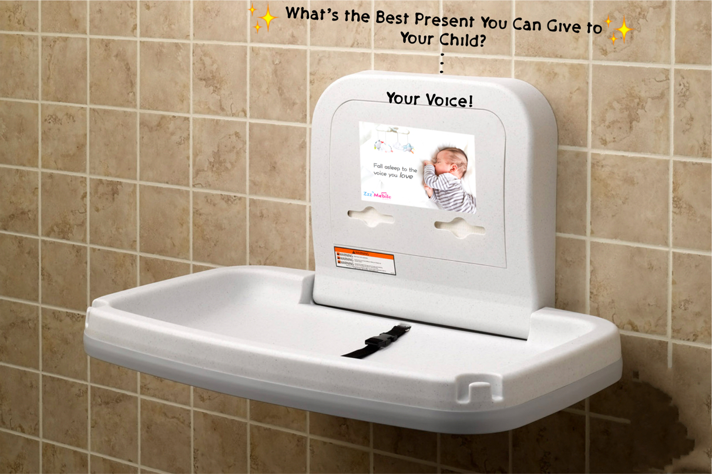
Campaign Highlights: Targeting Malls
RETURN
Sticker Ad Campaign
6 Mall Locations
~2% Annual Awareness

Slide 32
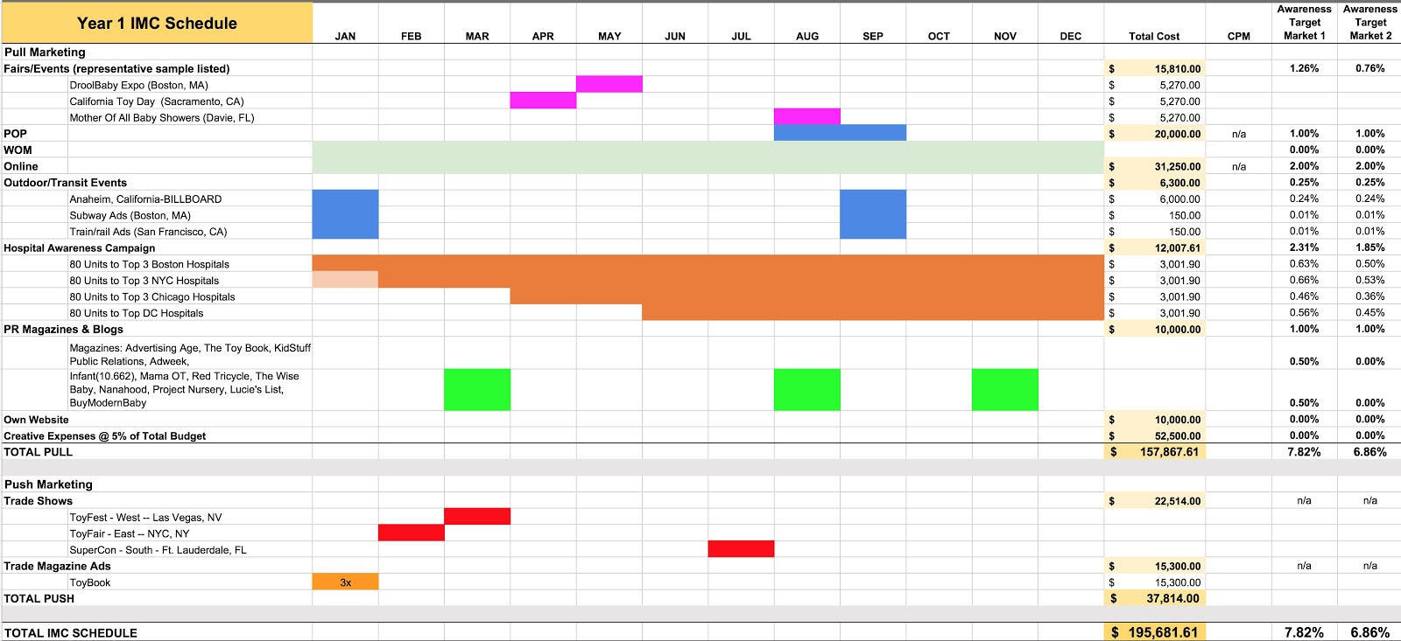
IMC Schedule Year 1
RETURN

Slide 33
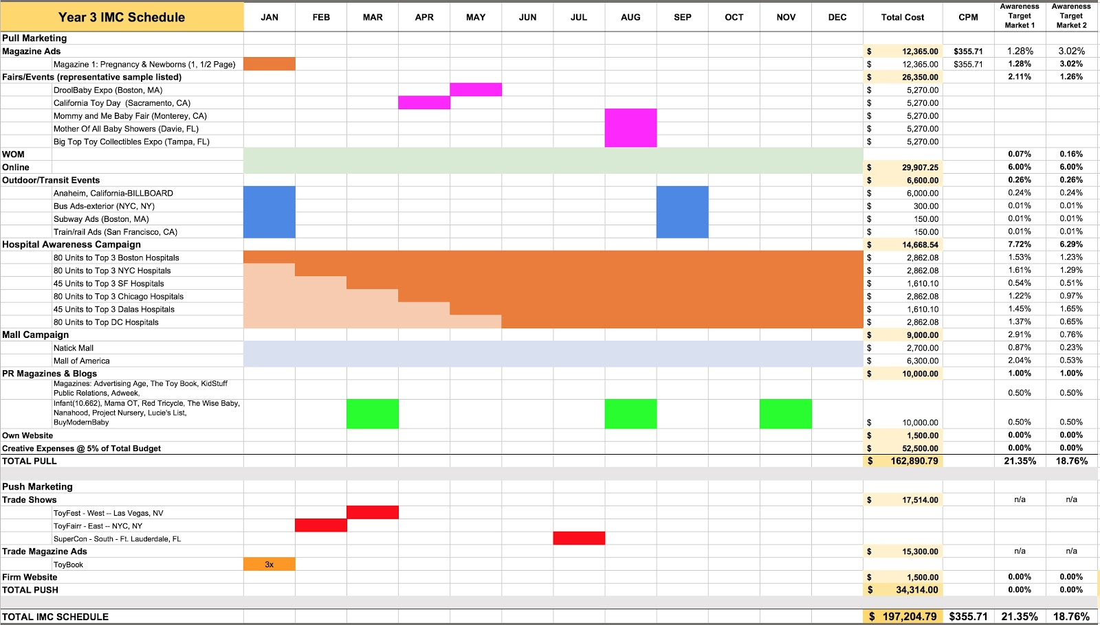
IMC Schedule Year 3
RETURN

Slide 34
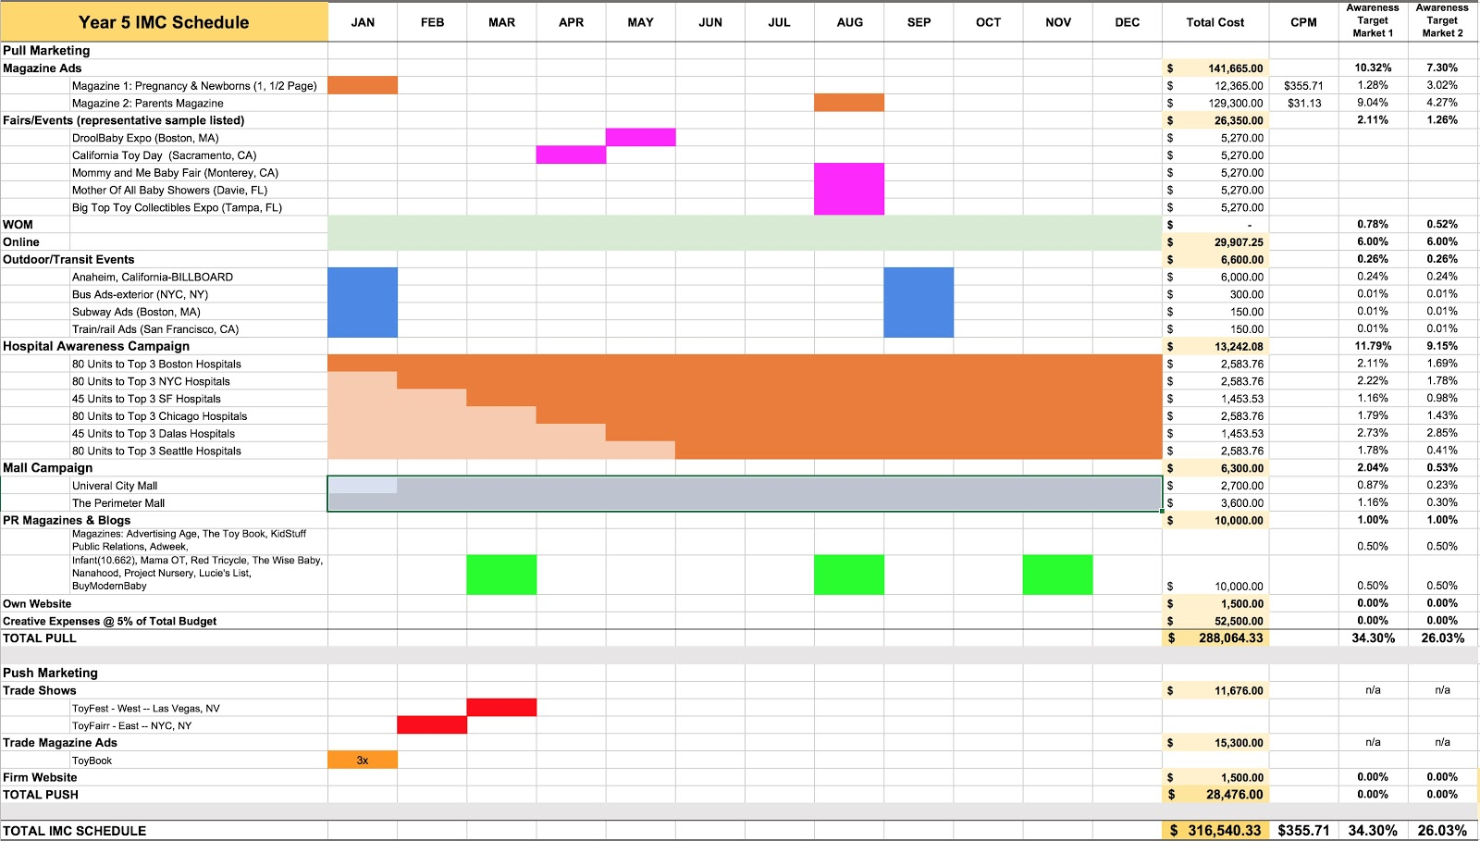
IMC Schedule Year 5
RETURN

Slide 35
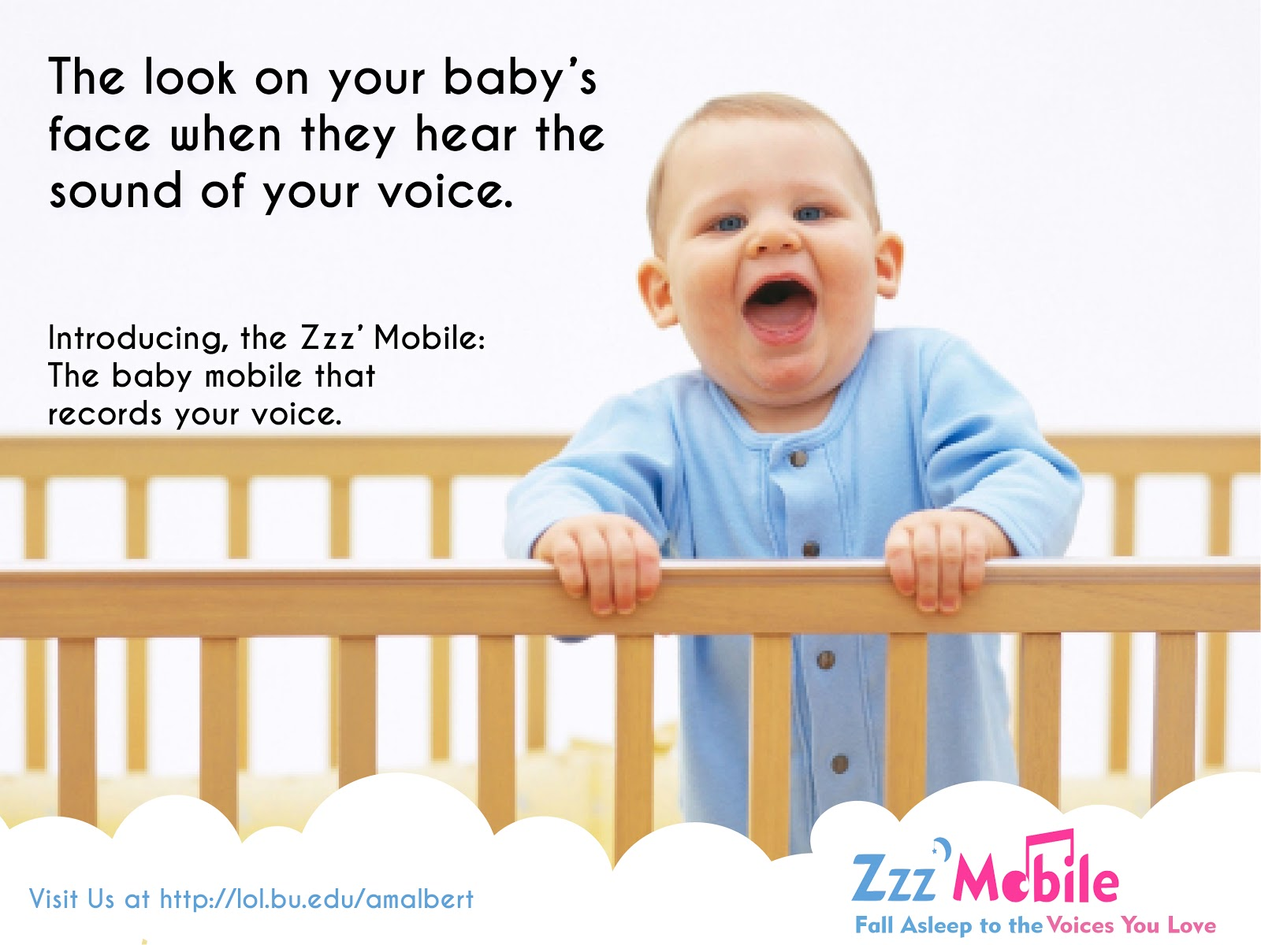
Billboard/Outdoor Advertising
RETURN

Slide 36
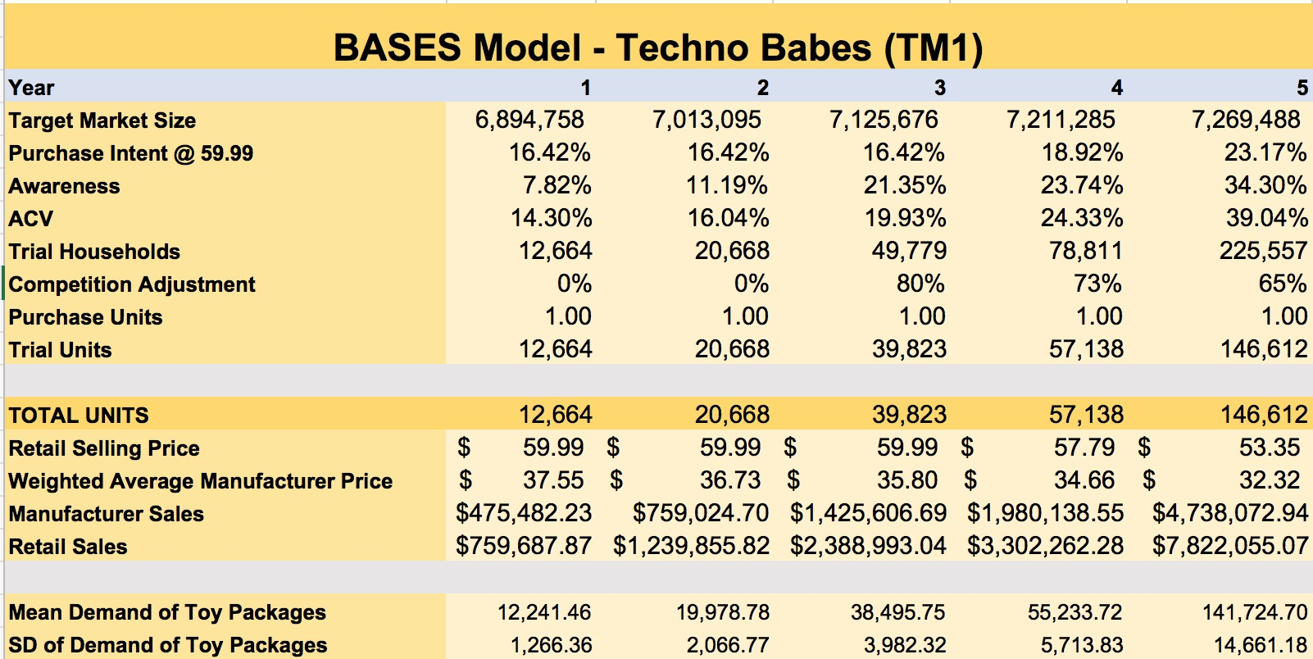
BASES Model – Techno Babes
RETURN

Slide 37
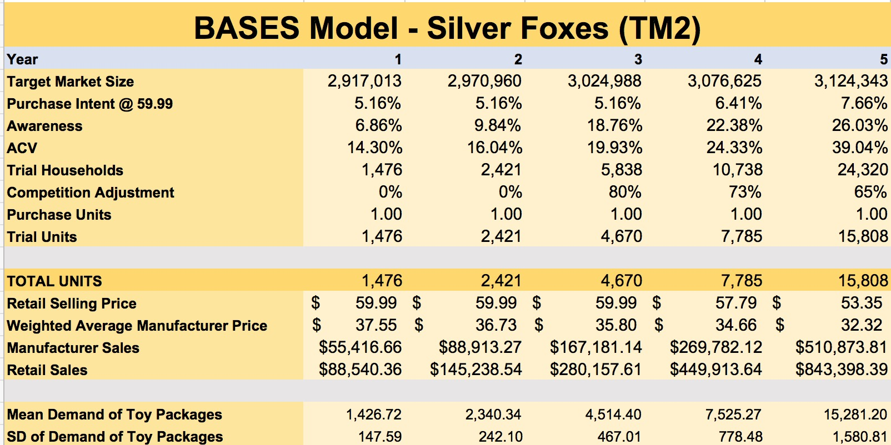
BASES Model – Silver Foxes
RETURN

Slide 38
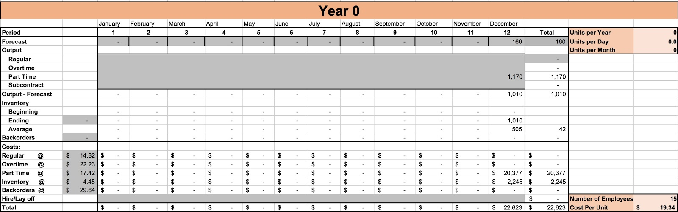
Aggregate Demand Year 0
RETURN

Slide 39
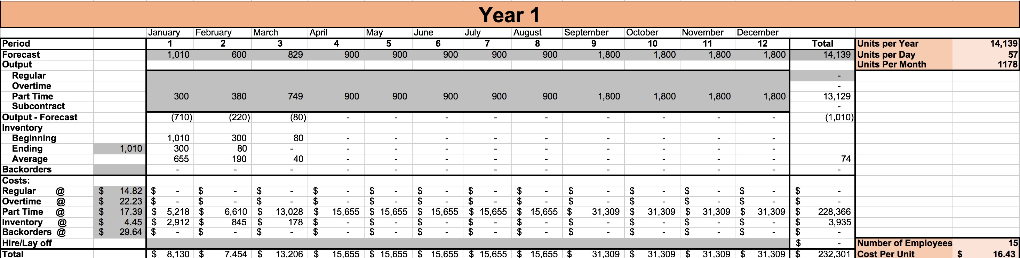
Aggregate Demand Year 1
RETURN

Slide 40
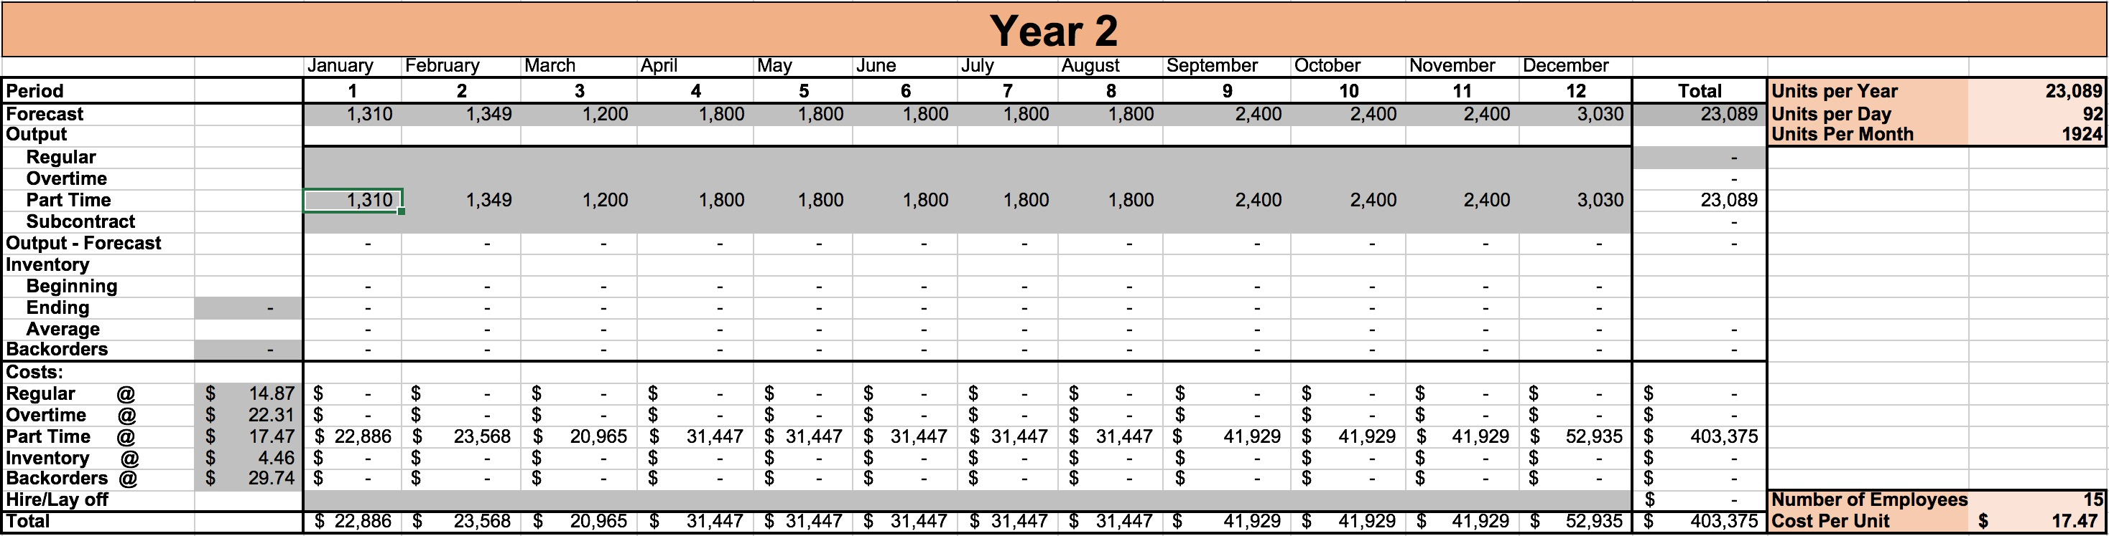
Aggregate Demand Year 2
RETURN

Slide 41
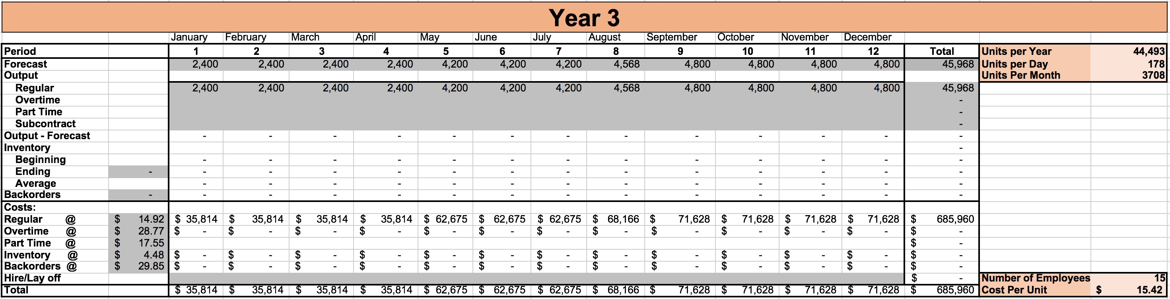
Aggregate Demand Year 3
RETURN

Slide 42
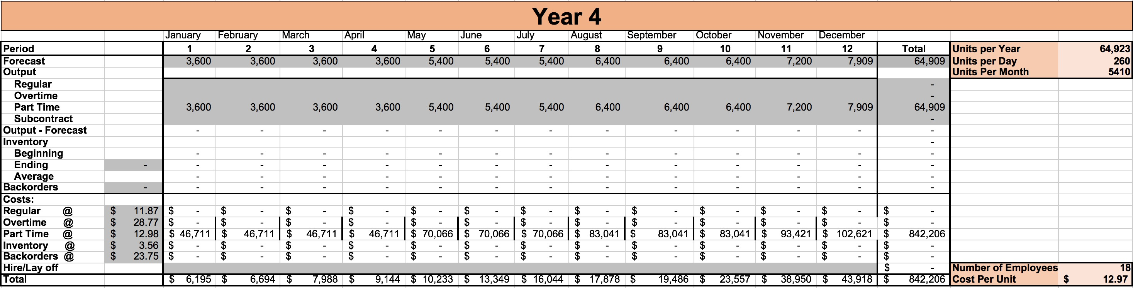
Aggregate Demand Year 4
RETURN

Slide 43
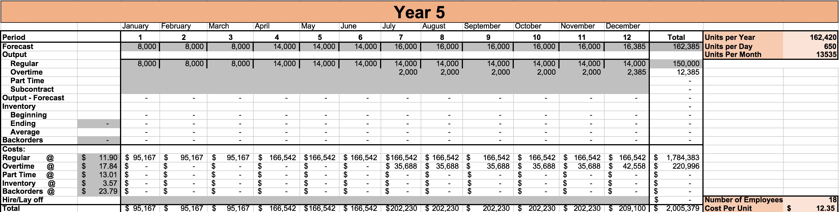
Aggregate Demand Year 5
RETURN

Slide 44
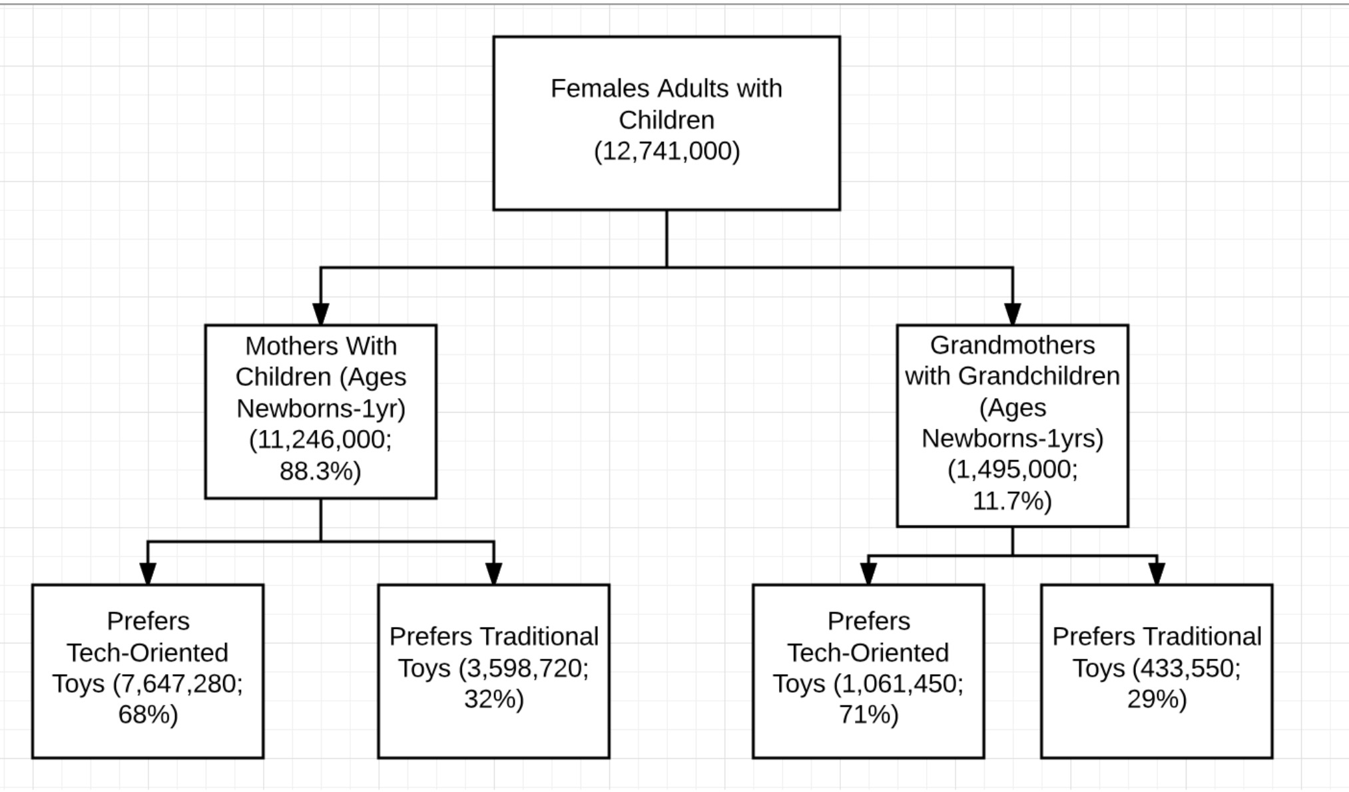
Segmentation Tree
RETURN

Slide 45
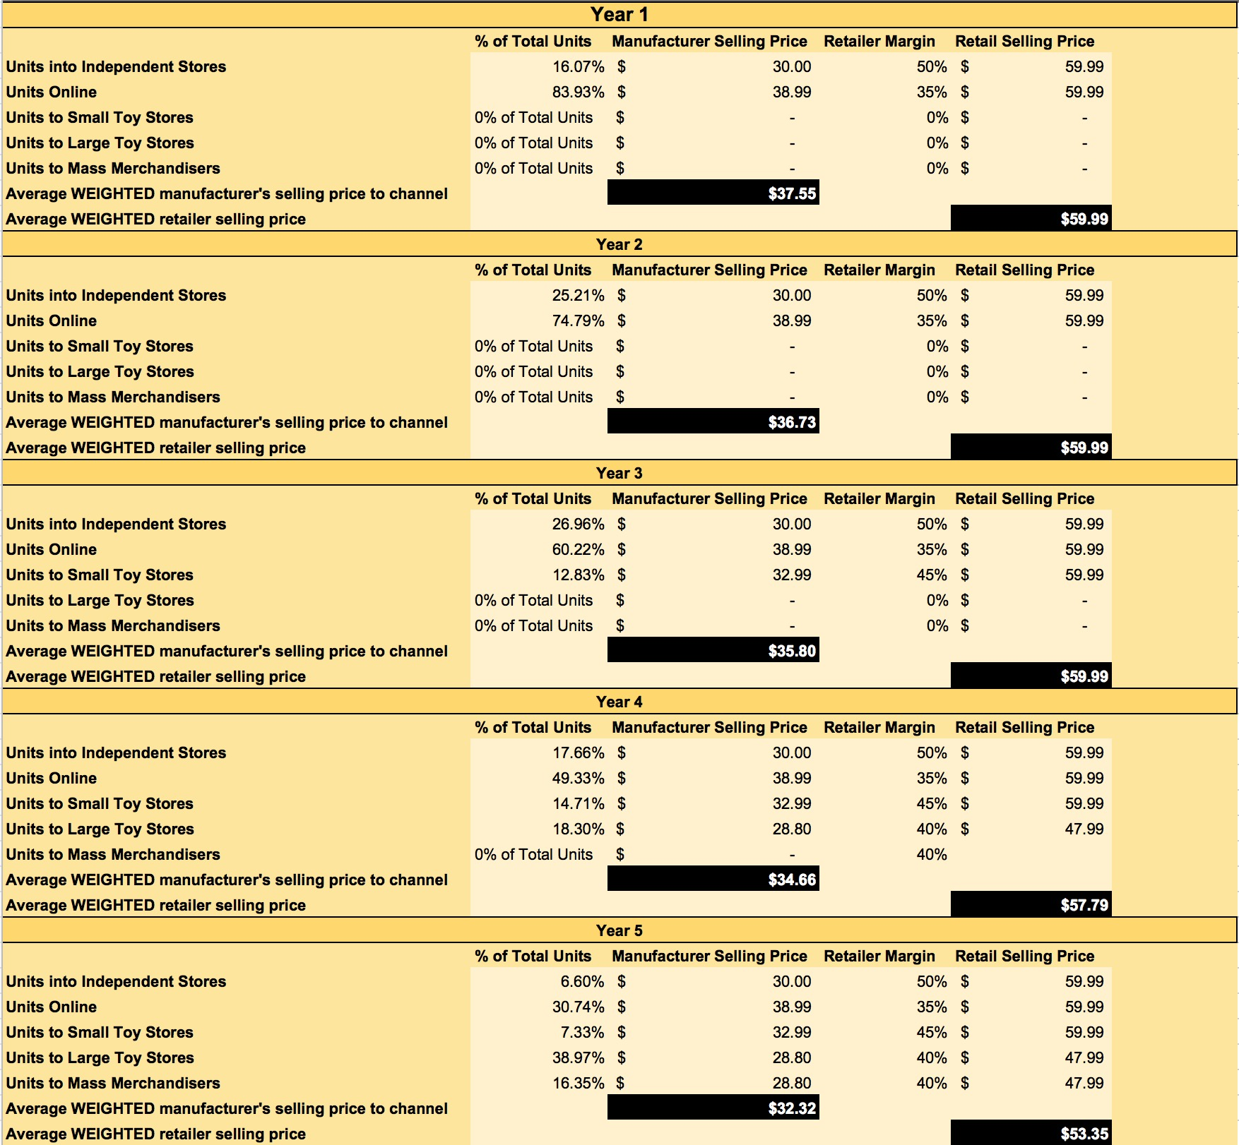
Avg. Weighted Manufacturers Selling Price
RETURN

Slide 46
Risk 3: Decreased ACV from Unreliable Retail Chain
RETURN
The key to surviving this risk:
-Increasing sales commission for sales people to 15%
05
04
03
Maintain a Positive NPV: $192K
02
Mitigation Strategies
01
33% Risk Probability
Third Largest Distribution for NPV
The Most Sensitive Variable
Unreliable Distribution Channels: Diminishes ACV by 5% Annually

Slide 47
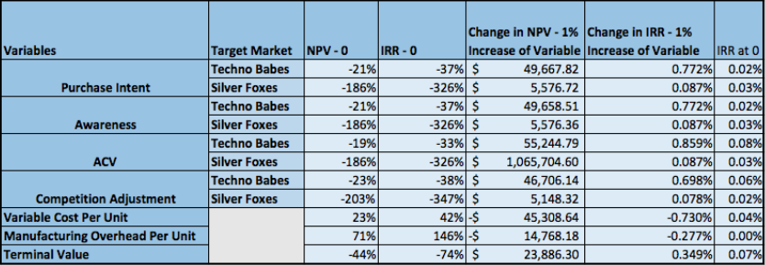
Sensitivity Analysis Output
RETURN

Slide 48
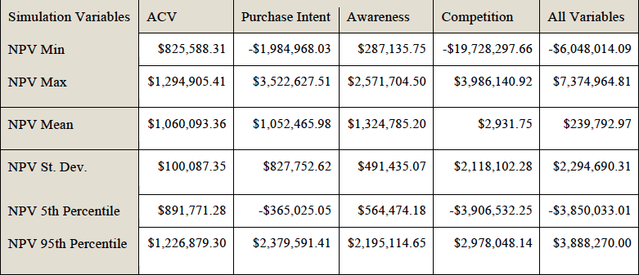
Risk Simulation Output
RETURN

Slide 49
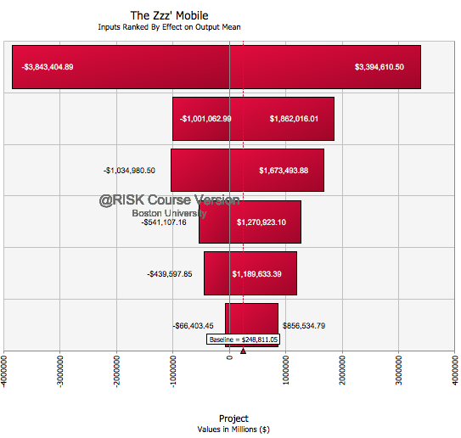
Risk Simulation Tornado Chart
RETURN
Competition
Purchase Intent @ $59.99 – Techno Babes
Purchase Intent @ $59.99 – Silver Foxes
Awareness – Techno Babes
Awareness – Silver Foxes
ACV

Slide 50
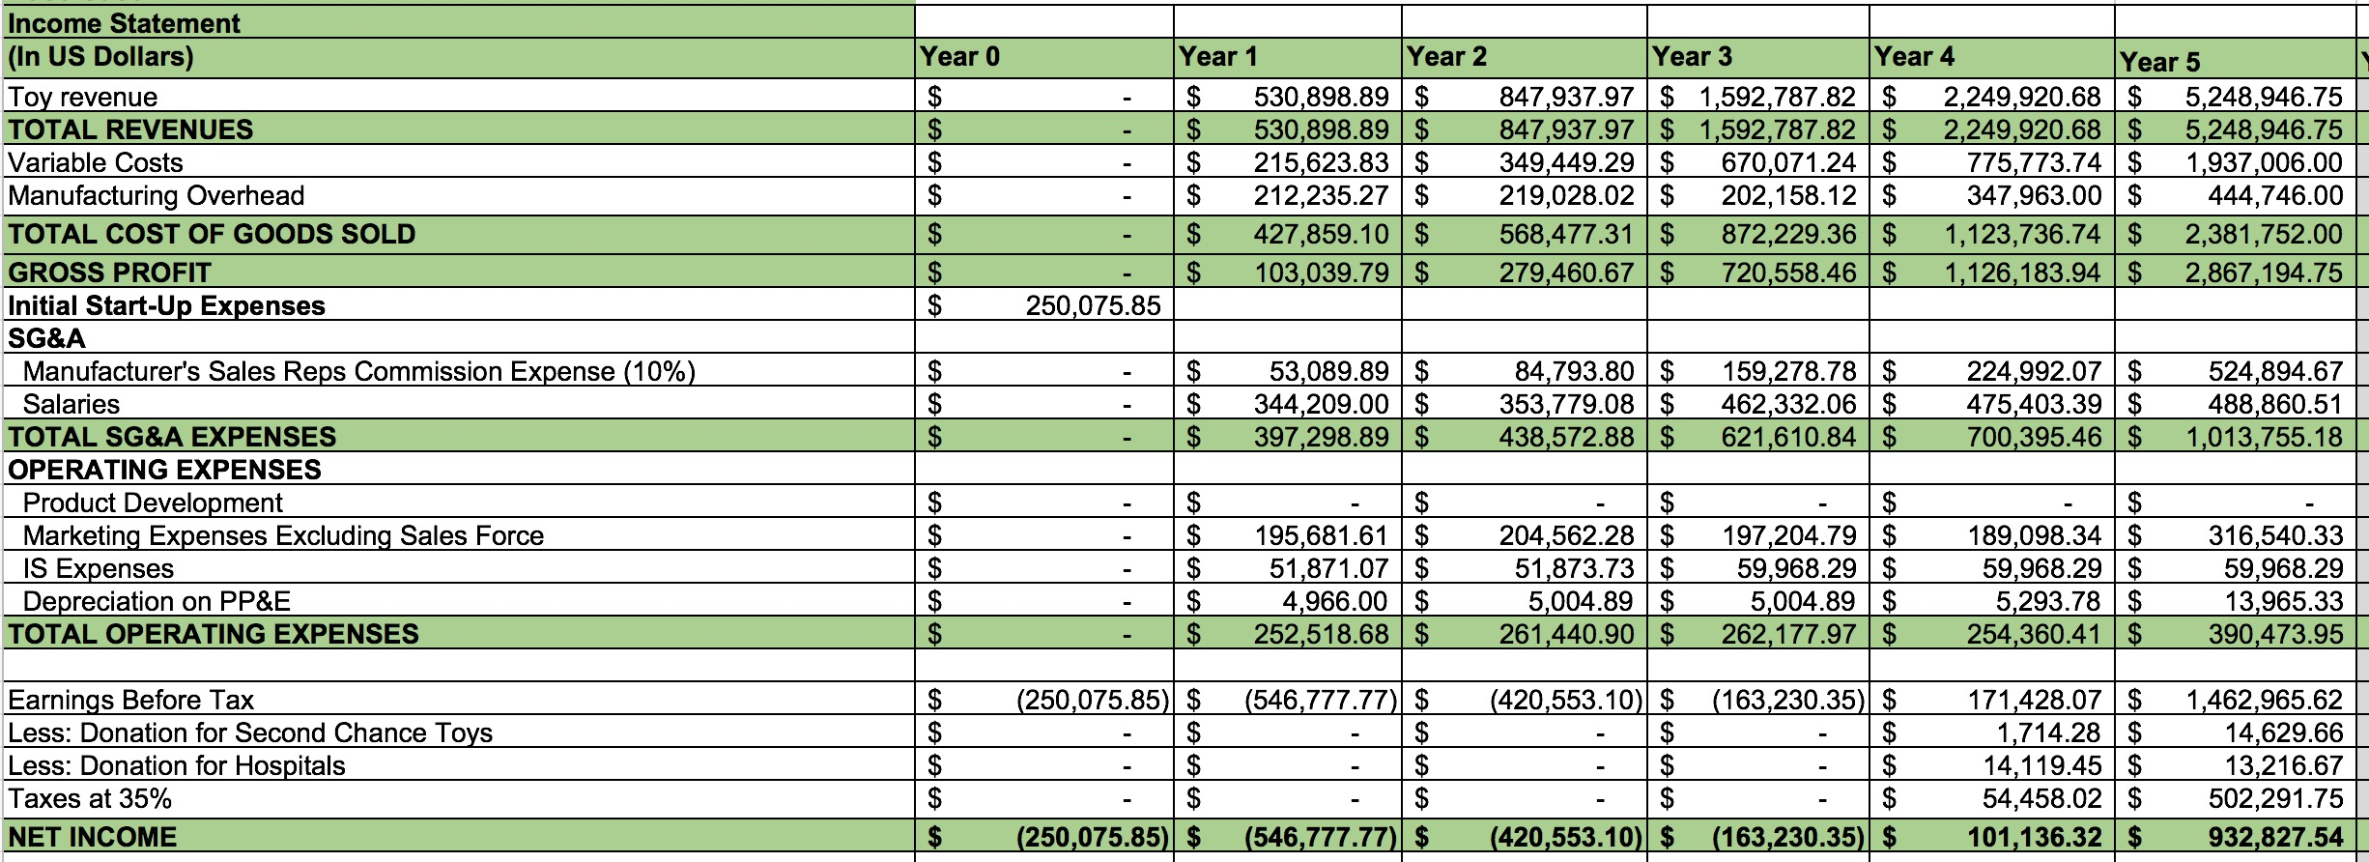
Income Statement
RETURN

Slide 51
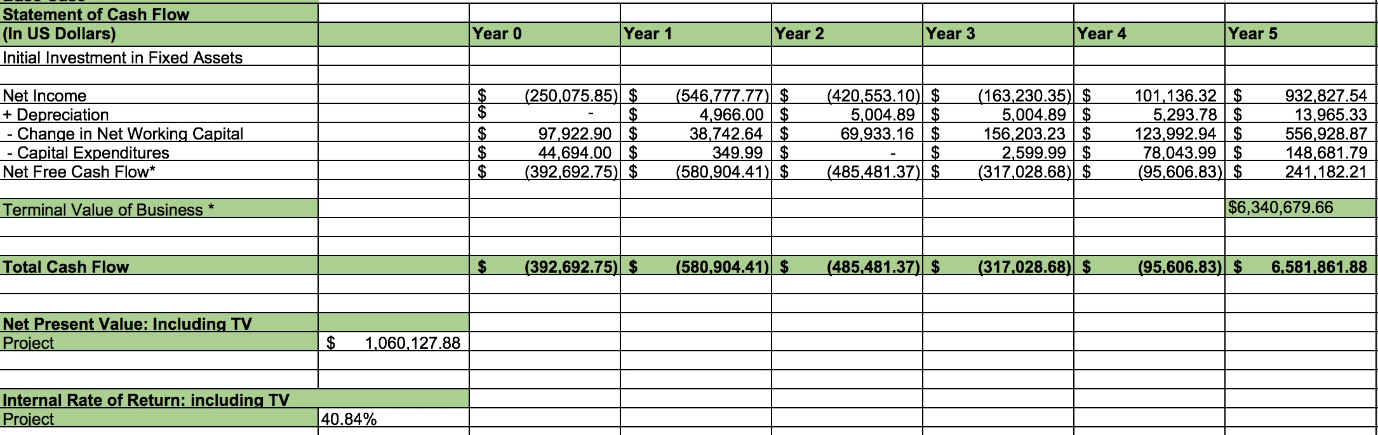
Statement of Cash Flows
RETURN

Slide 52
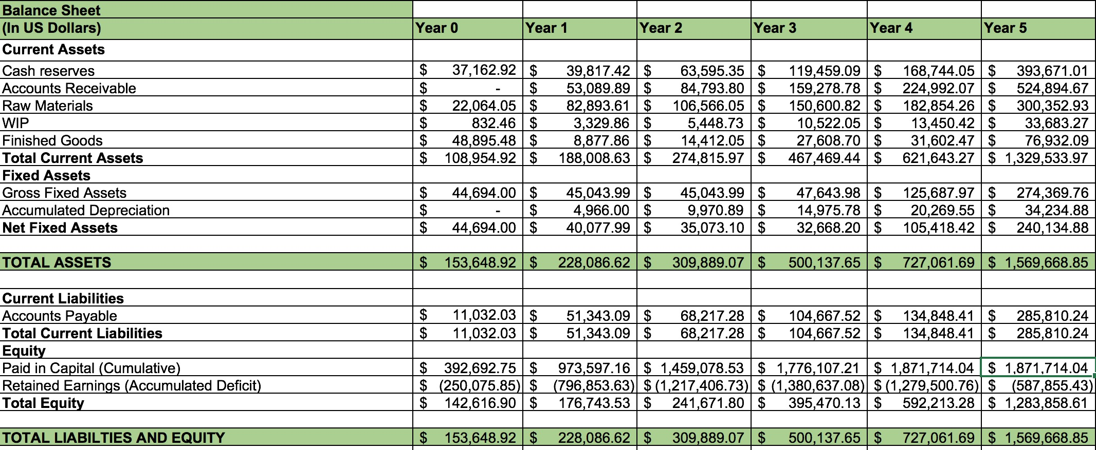
Balance Sheet
RETURN

Slide 53
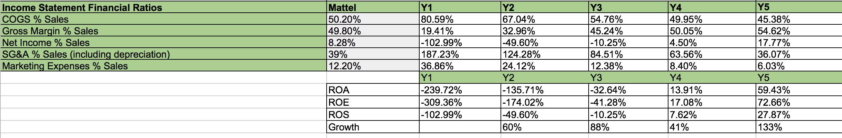
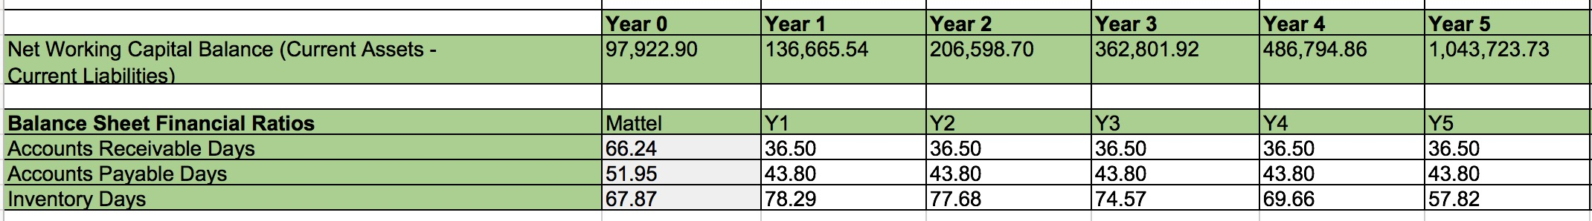
Ratios, NWC, & Retained Earnings
RETURN

